Slide 1
Breaking down the game:
A Football Analytics Platform
Group 18
Yash Koushik
Jainav Sanghvi

Slide 2
Problem Statement
In the realm of football analytics, efficiently processing and analyzing structured data poses a significant challenge.
The Football dataset, comprising player, team, and match information, presents a complex and interconnected dataset.
The problem lies in extracting valuable insights regarding player performance, team statistics, and tournament statistics from this vast dataset.
Traditional approaches using relational databases struggle to handle the volume and complexity of football data, necessitating an alternative solution.

Slide 3
Motivation
The motivation behind this project is to address the limitations of traditional relational databases in football data analysis.
By leveraging NoSQL technologies, we aim to provide a scalable and flexible solution for processing and analyzing large football datasets.
The demand for data-driven insights in the football industry is rapidly increasing, with teams, players, and fans seeking in-depth analysis and performance evaluation.
Our project aims to meet this demand by delivering a user-friendly platform that empowers users to explore and uncover valuable insights from football data.
By employing a structured data processing approach and utilizing NoSQL systems, we can unlock the potential of football data and contribute to the advancement of football analytics.

Slide 4
Approach and Implementation:

Slide 5
Our project adopts a comprehensive approach to efficiently process and analyze football data using structured data processing techniques and NoSQL systems.
The approach encompasses specific algorithms, tools, and models chosen based on their suitability for the problem at hand.
Emphasis is placed on simplicity and user-friendliness by developing reusable pipelines.

Slide 6
NoSQL Technologies
NoSQL technologies, such as Flask, PyHive, and Hive, are leveraged to handle the complex and interconnected nature of football data.
Apache Hive and HiveQL provide SQL-like querying capabilities, enabling data analysis and calculation of player statistics, team performance metrics, and match predictions.
Hive's scalability and distributed processing capabilities make it an ideal choice for analyzing large football datasets.
Flask, a lightweight web framework, acts as the backend for establishing API routes and facilitating communication with the Hive database through PyHive.

Slide 7
Justifications for Tool Selection
Flask is selected for its simplicity and flexibility in building web applications, providing a robust API layer between the frontend and backend components.
Hive is chosen due to its integration with Hadoop, SQL-like HiveQL query language, and ability to handle large-scale data processing.

Slide 8
Dataset and Data Modeling
The primary dataset used in this project is the Football dataset, containing comprehensive information about players, teams, and matches.
A suitable data model is designed to represent the football data in a structured manner, stored in the NoSQL database Hive.
The flexible schema and scalability of Hive ensure efficient retrieval and processing of information.

Slide 9
Optimizing Data Analysis with Partitioning in Hive
Partitioning in Hive divides data into smaller segments based on specific criteria.
Partitioning by 'tournament_name' reduces query runtime, improving performance.
Hive operates on a subset of data with partitioning, avoiding full dataset scanning.
Query execution time is significantly reduced by narrowing the search space.
Without partitioning, Hive scans the entire dataset, leading to time and resource consumption.
Partitioning allows Hive to access relevant partitions, resulting in faster execution.
Significant performance improvements achieved through partitioning in data analysis.
Hive's distributed processing and partitioning efficiency benefit football data analysis.

Slide 10
Front-End Interface with React
The front-end interface is built using React, a JavaScript library known for its efficiency and flexibility in creating user interfaces.
React enables the development of a dynamic and interactive interface, providing real-time updates and seamless navigation.
The interface comprises pages for player details and stats, team stats for the FIFA World Cup, and FIFA tournament stats for a specific year, offering users specific functionalities and insights into football data.
React components capture user input, form validation, and state management, facilitating efficient processing and analysis based on user selections.

Slide 11
User-Friendliness and Reusability
The approach emphasizes user-friendliness and reusability by developing modular data processing pipelines.
The pipeline includes data ingestion, data cleaning and pre-processing, and data analysis and visualization steps.
The pipeline's modularity allows for easy adaptation to other datasets or future use-cases, promoting efficiency, consistency, and scalability.
The user-friendly frontend interface, coupled with reusable pipelines, enables users to process and analyze data without extensive technical knowledge, empowering them to derive valuable insights from the football dataset.

Slide 12
System Demo and Evaluation

Slide 13
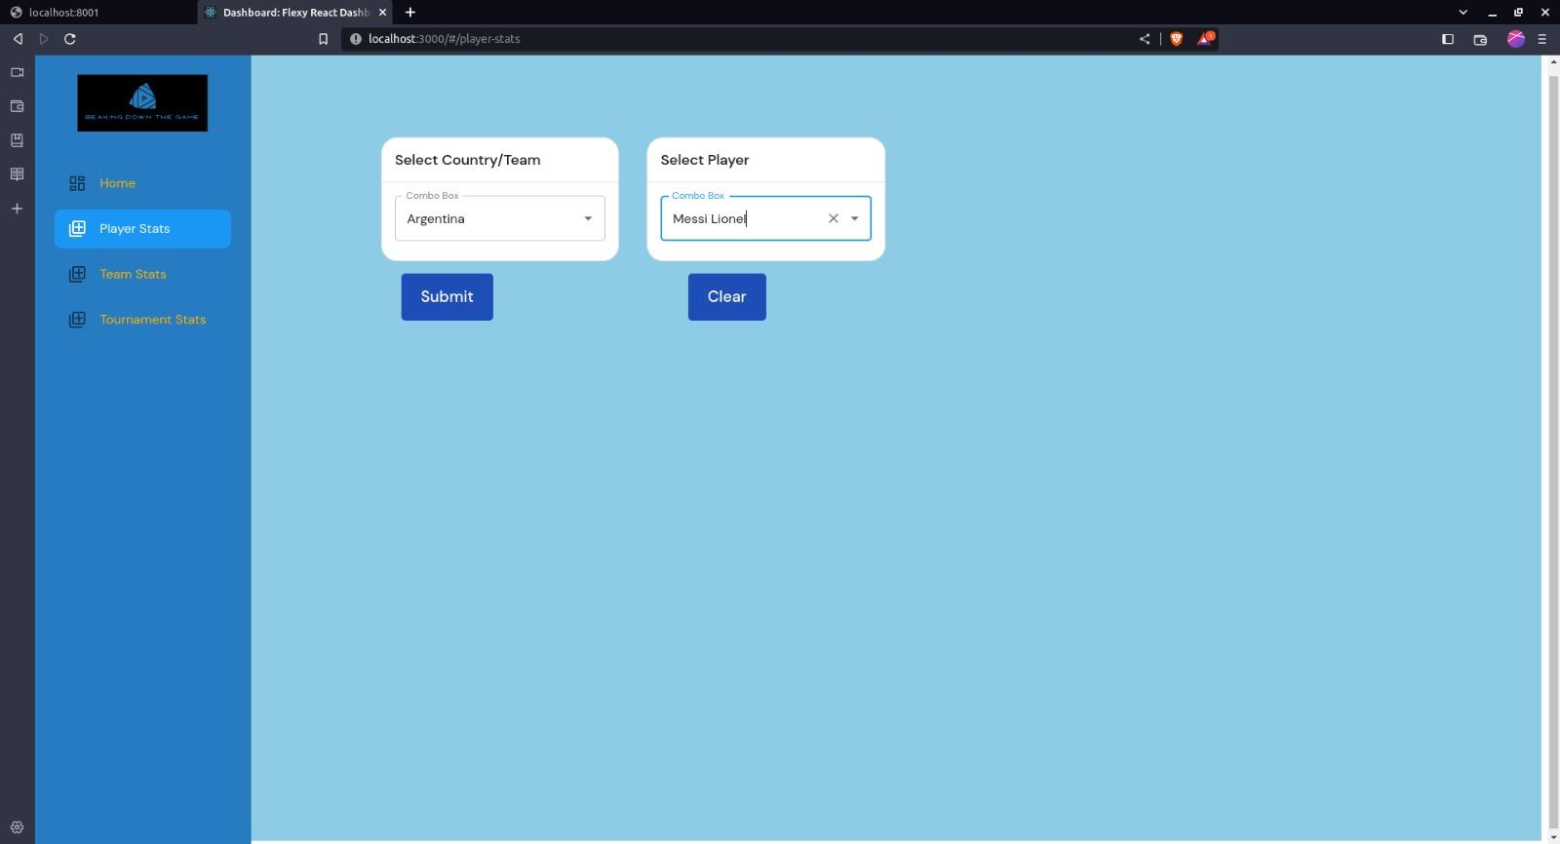

Slide 14
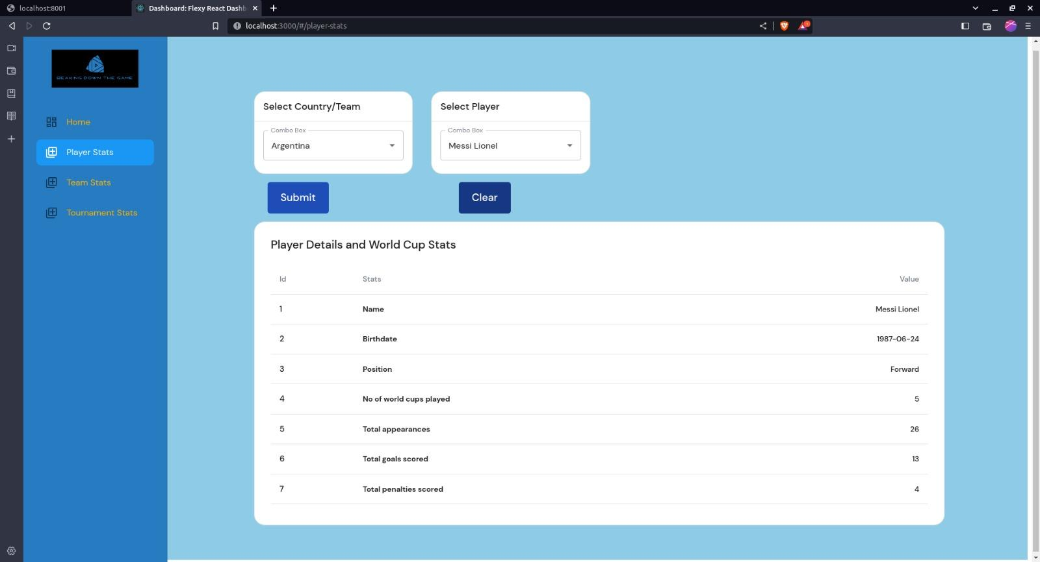

Slide 15
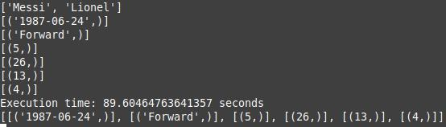

Slide 16
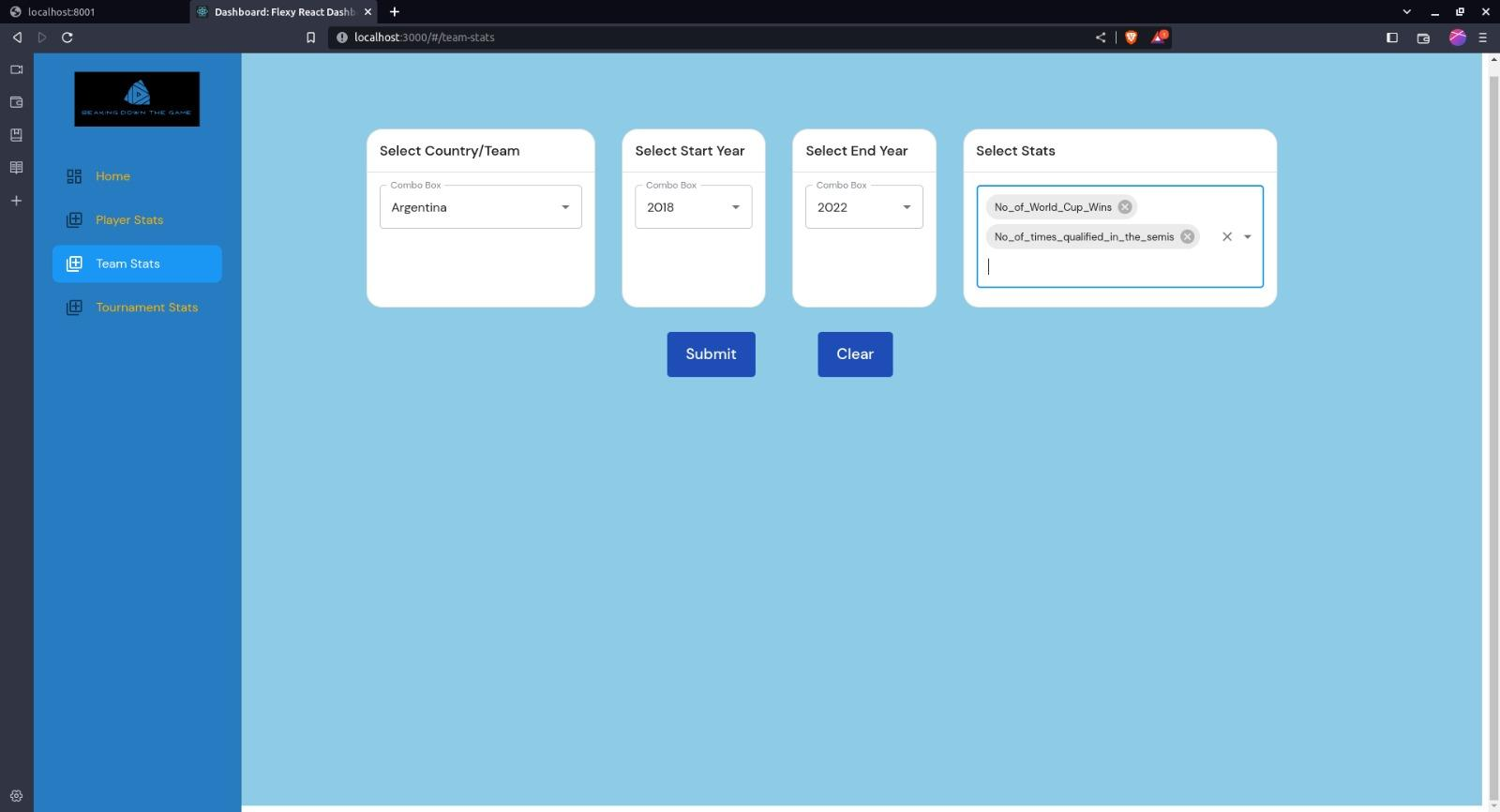

Slide 17
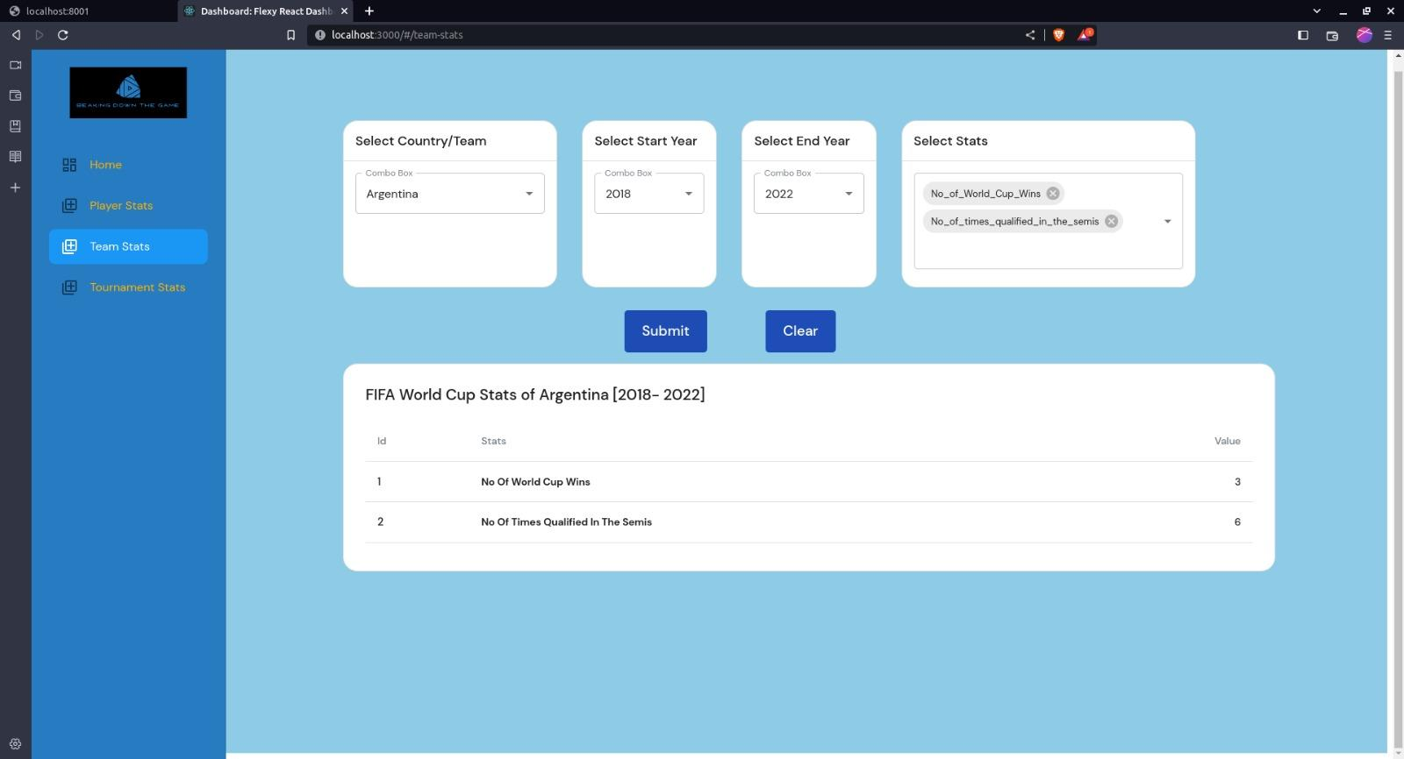

Slide 18
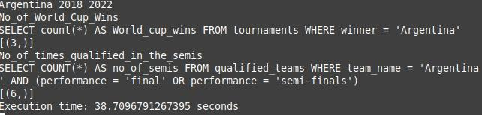

Slide 19
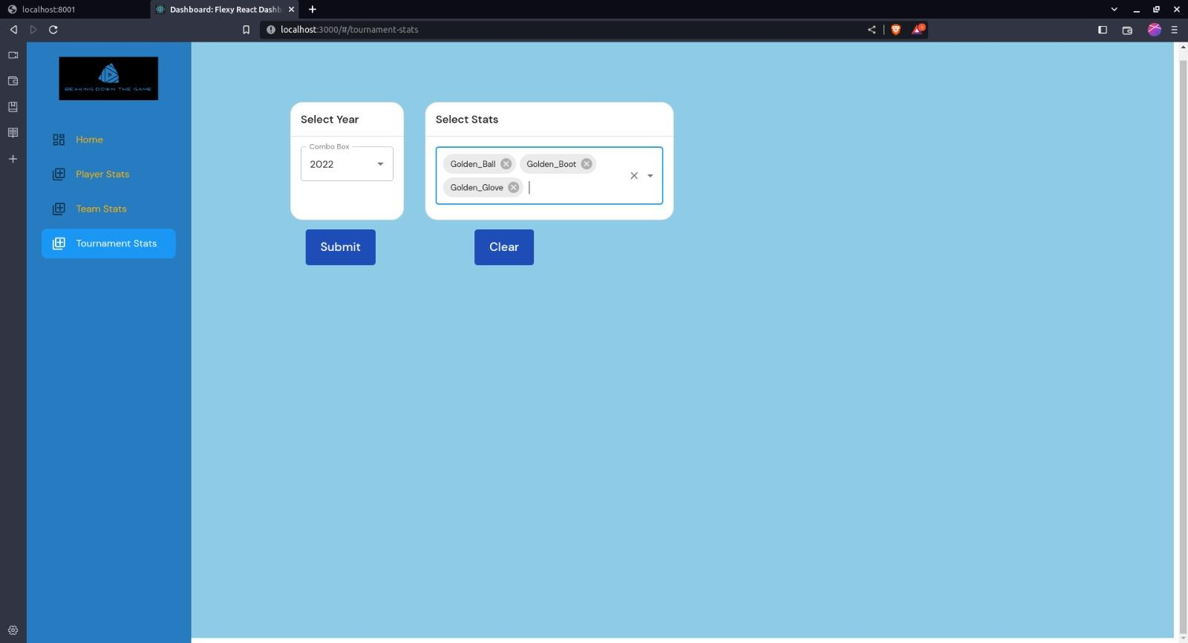

Slide 20
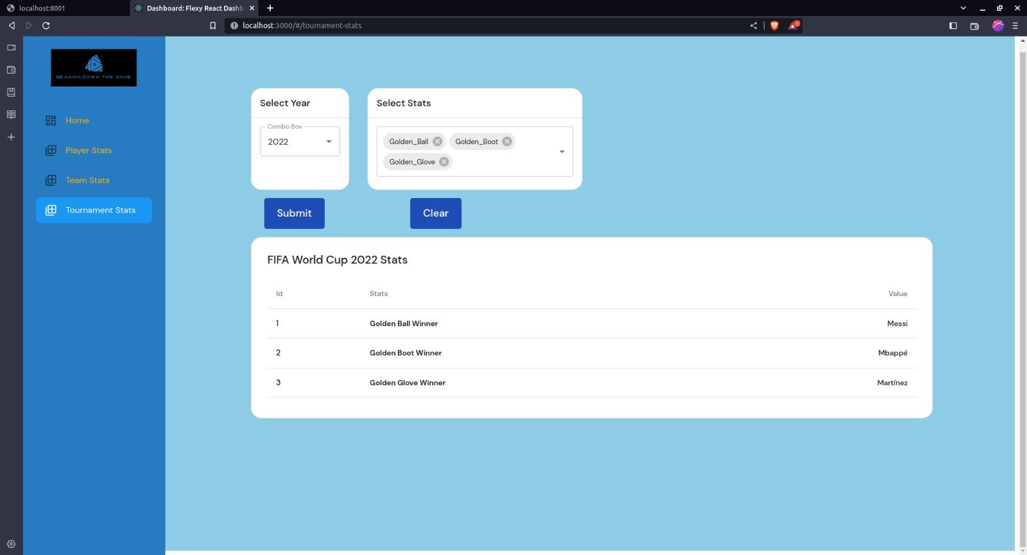

Slide 21
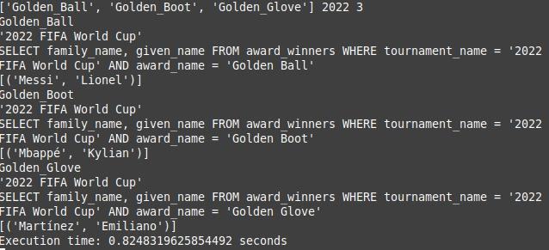

Slide 22
Conclusions
NoSQL technologies, particularly Hive, proved effective in processing and analyzing large volumes of structured football data, enabling valuable insights into player performance, team statistics, and match outcomes.
The development of a user-friendly football analytics platform enhanced data accessibility and usability, empowering users to interact with the data, explore visualizations, and derive meaningful insights effortlessly.
The adoption of a reusable pipeline approach simplified data processing, promoting efficiency, consistency, and scalability while ensuring adaptability to future datasets and use-cases.

Slide 23
Lessons Learned
Proper data modeling is crucial for effective analysis, enabling efficient storage, retrieval, and processing of football data. Consider the relationships and dependencies between data elements to ensure accurate insights.
Prioritize user experience by building intuitive interfaces with controls, real-time updates, and visually appealing visualizations. Continuously improve the user experience based on feedback and user testing.
Reusability and modularity lead to efficiency and scalability. Develop reusable data processing pipelines that allow for easier replication and adaptation to new datasets or use-cases.
Ensure data quality and consistency. Implement data cleaning and preprocessing steps as necessary to address data quality concerns and ensure reliable and accurate analysis results.
Collaboration and teamwork are essential. Leverage multidisciplinary expertise, effective communication, and coordination to successfully execute projects and develop comprehensive analytics platforms.

Slide 24
Thank you!

